Slide 1

GLOBAL PROTECTION FORUM
1ST TECHNICAL WEBINAR
ON HPC 2021 PLANNING
8th / 9th July 2020

Slide 2
AGENDA
Welcome
Key messages from Global Coordinators: for ensuring an effective, simplified and harmonized approach for HPC 2021 (20 min)
HPC Step-by-Step process: presentation and feedback on key elements and recommendations for ensuring integration of centrality of protection and inclusion lens in HNOs and HRPs (25 min)
Q&A (30 min)
Break (10 min)
HNO Guidance: presentation and feedback on key elements and approach planned for enhanced inter-sectoral and sectoral severity analysis and PIN calculations (25 min)
Q&A (30 min)
Wrap-up: guidance, resources and support that will be available from GPC and its AOR (10 min)

Slide 3
OBJECTIVE & EXPECTED OUTPUTS
Common understanding of key elements and approach for 2021 HPC, to have an effective and harmonized planning cycle.
Present and discuss key elements and proposed approach for inter-sectoral and sectoral analysis feeding into HNOs.
Obtain feedback from field colleagues to inform finalization of global guidance and tools for HPC.
Outline support and resources that will be available from global team for 2021 HPC.

Slide 4
1. KEY MESSAGES FOR HPC 2021

Slide 5
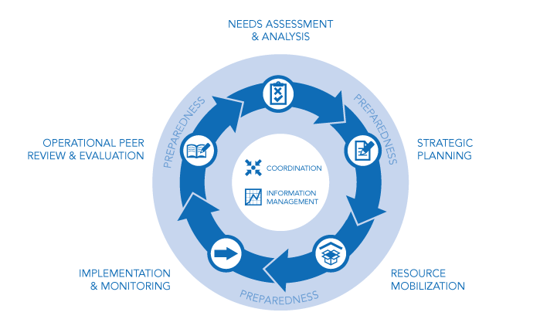
1. We are advocating for a simplified 2021 HPC process, considering this year challenges and multiple processes
We have advocated with all Global Clusters to ensure a simplified JIAF Guidance (to be used for HNOs 2021).
We are advocating that no major changes are introduced this year in HPC processes (i.e. no change in costing methodologies used in 2020)

Slide 6
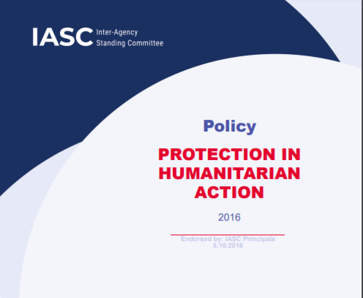
2. Joint analysis of protection risks, violations and harm should be a central element of inter-sectoral analysis (HNOs)
We have worked within JIAG to ensure the analysis of protection risks, threats and vulnerabilities is a key element of the JIAF/HNO methodology (in line with Centrality of Protection principle)
Particular to define the scope of the humanitarian analysis and response, i.e. jointly agree on priority affected geographical areas and population groups.
And to identify key underlying factors driving humanitarian consequences / conditions

Slide 7
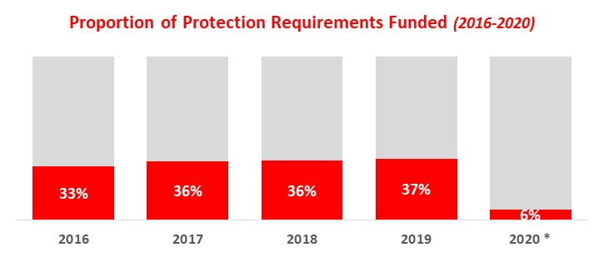
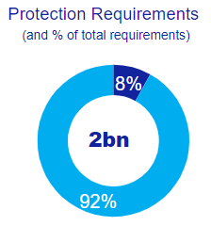
3. We need to address the under-representation and under-funding of protection responses
We are setting targets and benchmarks against our minimum package: (1) protection should constitute at least 15-20% of total humanitarian requirements, (2) it should be funded at least at 50%, and (3) other clusters mainstream protection through at least 5% of their programmes.
We will continue active dialogue with donors to boost protection resources.

Slide 8
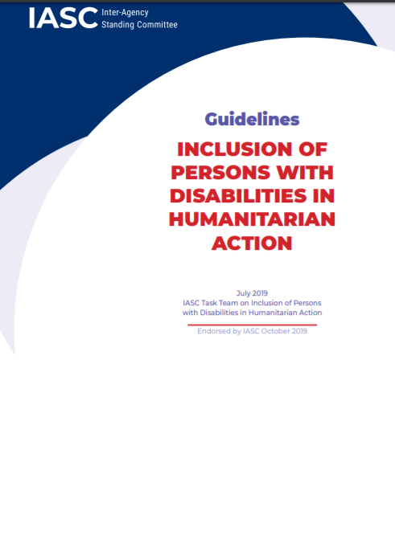
4. We should reinforce our efforts to ensure inclusive and people-centred HNOs/HRPs
Enhanced efforts to ensure inclusivity through disaggregated analysis of the differential impacts of the crisis on diverse groups of people (i.e. gender, age groups, disability and other diversity characteristics), both in the inter-sectoral as well as the protection sector-specific sections
- Enhanced efforts to consider priorities of affected populations to inform the analysis and promote community active participation through enhanced communication and engagement with communities throughout the project cycle, by identifying and leveraging community resources and capacities.

Slide 9
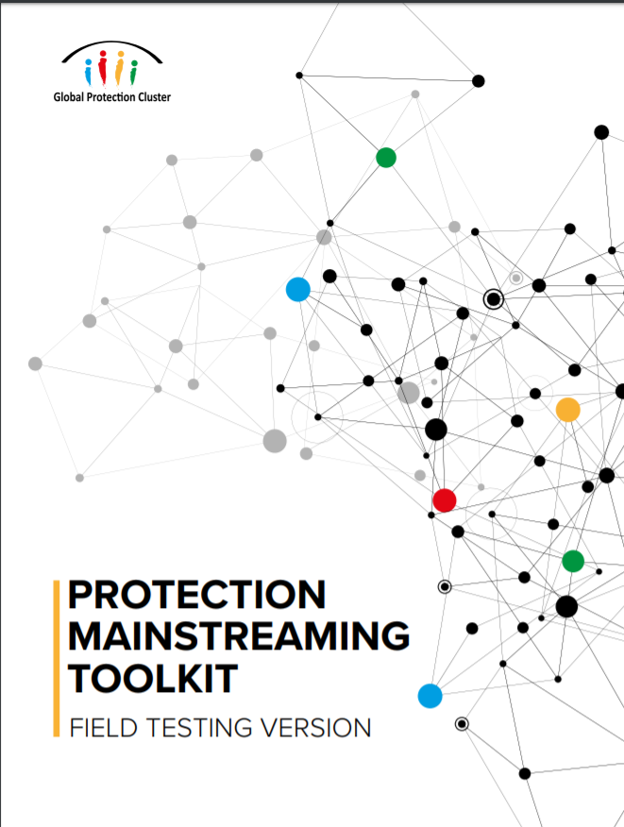
5. We aim to strengthen and expand integrated approaches and multi-sectoral responses
Engage in early discussion with other clusters to ensure that protection risks inform sectoral analysis and response priorities, promoting integrated/joint programming with protection actors
Take advantage of available guidance for integrated approaches, i.e. GPC and Global Health Cluster Joint Op. Fram., GPC / CP / MA / Education / Health Cluster Guidance for Child Victims of EO, etc.
Advocate with donors together with other sectors (ideally with active support and participation of relevant lead agencies and NGOs) to prioritize joint/integrated programming in their funding strategy to enhance the centrality of protection – including protection mainstreaming/do no harm

Slide 10
6. We need to ensure systematic inclusion of AoR specific sections in HNOs and HRPs
We need to build on the progress observed in 2020 HPC (70-75% of HNOs/HRPs with specific AoR sections) and aim to systematically include AoR-specific sections within the Protection Cluster chapter in all HNOs and HRPs as already included in the enhanced templates
As well as further visibility to other key protection areas, in particular: Protection of Civilians, Anti-trafficking, MHPSS, Protection of Older Persons / Persons with Disability, among others

Slide 11
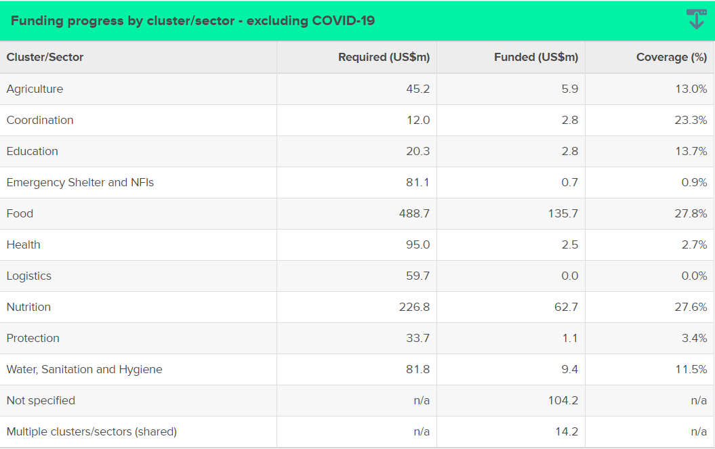
7. The set-up of HPC Tools should follow global policy agreed with OCHA for the Protection Cluster, ensuring AoRs-specific disaggregation and tracking
The GPC and AoR are engaging OCHA at global level to ensure that all OCHA field offices and protection clusters and AoR get a clear message to ensure a systematic / harmonized set-up of the different HPC tools (Response Planning Module, Projects Module, FTS) to allow disaggregation, reporting and tracking of AoR projects/activities and data

Slide 12
2. HPC STEP-BY-STEP PROCESS:
KEY ELEMENTS AND RECOMMENDATIONS
Notes:
25 min

Slide 13
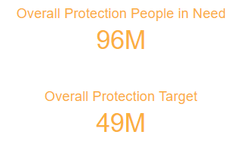
HPC 2020 SUMMARY
28 countries with HNOs
25 countries with HRPs (3 not yet published)
96M Overall PiN of Protection *
49M Overall People Targeted for Protection *
2.0B Protection Requirements (1.7B non-COVID)
* Not including COVID-19

Slide 14
HPC 2020: KEY HIGLIGHTS
Protection concerns analysis systematically featured in inter-sectoral narrative (high score in independent scoring process)
Enhanced protection analysis in sectoral chapters, including AoR specific figures and narrative
Enhanced SADD analysis and figures
Majority of HRPs included AoR-specific requirements and response priorities
Increased reference to integrated programming
Collaboration / communication with GPC and AoRs (particularly for needs analysis)

Slide 15
HPC 2020: KEY CHALLENGES
Constrains for severity / needs analysis due to data availability
Mixed approach for inter-sectoral severity analysis and PiN calculations (confusing guidance on HC Pillars, lack / delays in global guidance)
Limited space for sectoral protection chapter narrative
Thigh deadlines and challenges with management of projects submission
Diversity in representation of protection funding requirements over total asks
Different approach for the set-up of HPC Tools, and AoR specific data not systematically disaggregated in FTS

Slide 16
HPC 2021: KEY CHANGES
Fundamental elements of the enhanced HPC approach will remain the same (simplified templates / merging of sections)
Revised guidance for joint intersectoral analysis (JIAF)
Anticipated increase use of secondary data and expert judgement
COVID-19 response to be integrated into 2021 HPC
Increased focus on risk analysis and projections

Slide 17
HPC 2021: KEY AREAS OF FOCUS
1. Active / lead role to ensure centrality of protection is properly reflected in inter-sectoral analysis and response prioritization (priority affected areas and groups)
(See Section 3 of the PPT)

Slide 18
HPC 2021: KEY AREAS OF FOCUS
2. Reinforced efforts to ensure inclusive and people-centred approaches in HNOs/HRPs
(See Next Slides by UNHCR/UNICEF Colleagues)

Slide 19
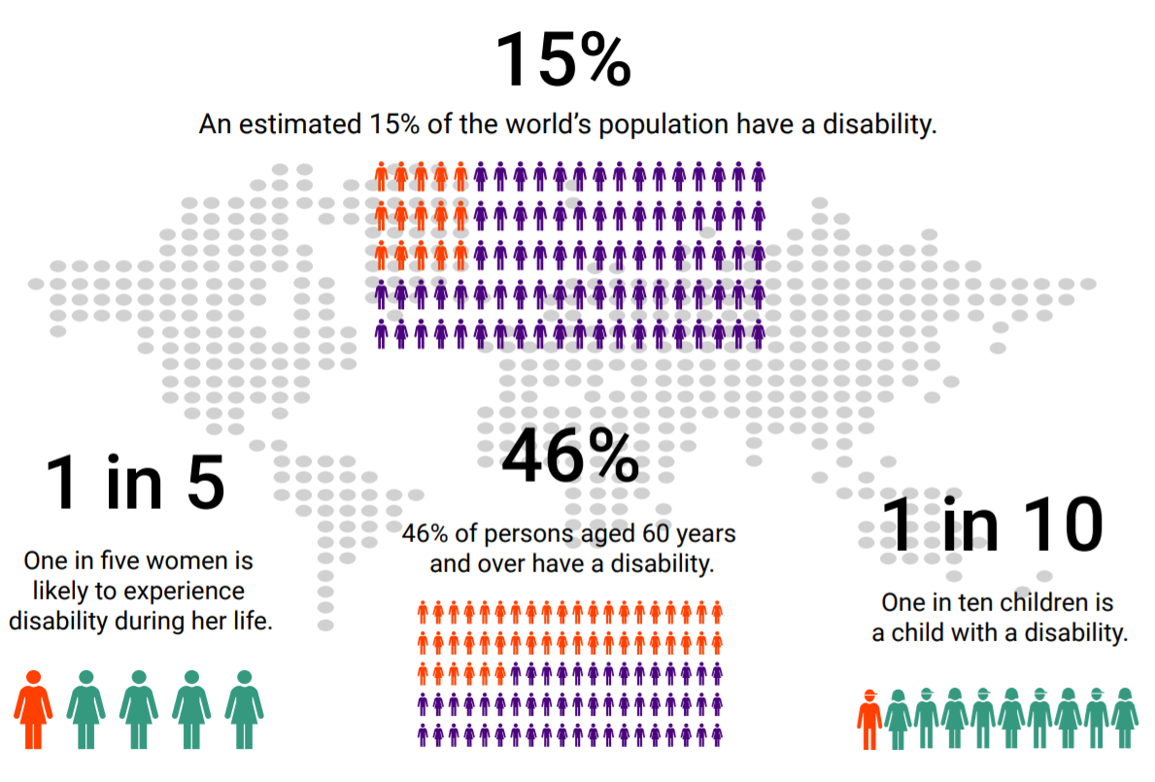
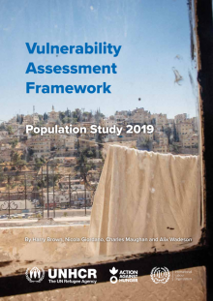
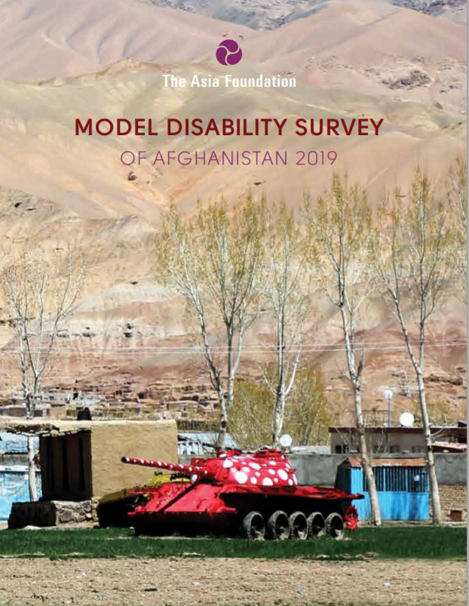
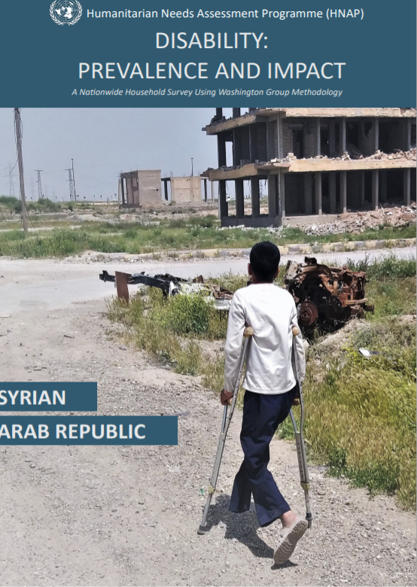


Why disability inclusion in HNOs/HRPs?
Jordan 21%
Afghanistan adults 13.9% “severe” – 65% “moderate/mild disability”
Syria 27%
Afghanistan children 17.3% “mild / moderate / severe” disability”
9% 65 or over
46%
54%
Notes:
Persons with disabilities are estimated to represent 15 per cent of the world’s population (higher in humanitarian contexts)
Among the most marginalized people in crisis-affected communities and are disproportionately affected by conflict and emergency situations.
Attitudinal, physical and communication barriers impede their participation and inclusion in humanitarian action.
Greater marginalization and discrimination due to the intersectionality (age, gender, ethnicity, location and race).
Sources:
Infographic: IASC Guidelines (estimate from 2011 WHO World Report on Disability)
Afghanistan: Model Disability Survey of Afghanistan 2019 https://reliefweb.int/report/afghanistan/model-disability-survey-afghanistan-2019
Jordan: Vulnerability Assessment Framework 2019 https://reliefweb.int/report/jordan/vulnerability-assessment-framework-population-study-2019
Jordan: GHRP COVID-19 In Jordan, a survey reported that 88 per cent of respondents could not go to the hospital for their regular checks or additional medical needs
Older age: According to data from World Population Prospects: the 2019 Revision, by 2050, one in six people in the world will be over age 65 (16%), up from one in 11 in 2019 (9%).
Percentage older women/men: https://www.helpage.org/blogs/florian-juergens-32033/social-protection-for-older-women-1092/

Slide 20
What did we learn from 2020 HPC disability inclusion review?
Analysis:
Analysis of factors contributing to risk & differentiation of persons with disabilities from other ‘vulnerable groups’ to produce a more nuanced analysis
Intersectionality:
Intersectional analysis- understanding how aspects of diversity intersect to impact risk
Participation:
Inclusive processes for consulting with persons with disabilities & Engagement of local OPDs
Data collection:
reliable and up to-date information is needed on people with a disability in the affected population and the barriers they face. Use of global disability prevalence estimates with caution and only with no other resources.
Twin-track:
Deliberate use of a twin-track approach to design & monitor the response

Slide 21
Related resources and guidance
Disability & HNOs/HRP
Guidance on strengthening disability inclusion in Humanitarian Response Plans
Tip Sheet: Integration of Disability in HNO
Tip Sheet: Integration of Disability in HNO
Disability & humanitarian response
IASC Guidelines, Inclusion of Persons with Disabilities in Humanitarian Action
UNICEF: Including children with disabilities in humanitarian action
Disability & COVID-19
Disability Inclusion: Tip sheet for GHRP update
Note on applying the IASC Guidelines on Inclusion of Persons with Disabilities in the COVID-19 response (under development)
GPC webcast on disability inclusive HNO and HRP

Slide 22
HPC 2021: KEY AREAS OF FOCUS
3. Ensure visibility of AoRs specific analysis and priorities (and enhanced visibility / consideration of other key areas of protection)

Slide 23
HPC 2021: KEY AREAS OF FOCUS
4. Harmonized approach for set-up and management of HPC Tools
RPM
For each HRP, one field cluster/coordination entity to be defined in RPM called “Protection”. All activities or indicators will be defined within one framework under that coordination entity.
This single field cluster will be associated in RPM with multiple ‘global sectors’, as relevant and appropriate for that plan (with the following exact labels). These sectors/sub-sectors are used for reporting purposes only, not for coordination.
    o Protection
    o Protection – Child Protection AoR
    o Protection – GBV AoR
    o Protection – MA AoR
    o Protection – HLP AoR

Slide 24
Projects Module
In Projects Module, project owners should submit their projects to a single field cluster. The financial requirements for each project will be divided in percentages adding up to 100% across the sectors/sub-sectors mentioned above.
For subsequent reporting, projects can be filtered or grouped by ‘field cluster’ which will show all projects together, or by ‘global sector’ which will show each separately.
Allow harmonized set-up for both project and activity-based costing

Slide 25
HPC 2021: KEY AREAS OF FOCUS
5. Comprensive response planning
Enhance and harmonized our results framework and response monitoring systems
Targets and financial requirements
Greater focus on integrated programming and protection mainstreaming

Slide 26
HPC 2021: EXPECTED INTER-AGENCY GUIDANCE
Updated HPC Step-by-Step Guidance, Templates and Timeline (mid-July)
Accompanying guidance on inter-sectoral analysis (JIAF), Risks analysis and projections; Prioritization, Response Analysis and Targeting; Monitoring (mid-July)
Additional guidance on costing methodologies, HPC Tools Management (TBC)
Tailored trainings (TBC)

Slide 27
HPC 2021: GUIDANCE FROM GPC
Sectoral guidance for HNOs: concrete recommendations for inter-sectoral and sectoral analysis (context-based analysis for identification of affected areas/groups, severity analysis and PiN calculations) (end-July)
Sectoral Guidance for HRPs: key recommendations and specific guidance on targeting, prioritization, costing, response frameworks and projects management (end-August)
Additional technical webinars (September + possibility of dedicated thematic webinars)
Dedicated remote and field support

Slide 28
DISCUSSION
Questions on the process / expected changes?
Additional challenges / areas that need focus and guidance / support from global team?
Good practices / lessons learn to highlight?

Slide 29
3. HNO GUIDANCE:
KEY ELEMENTS AND APPROACH FOR INTER-SECTORAL AND SECTORAL GUIDANCE

Slide 30
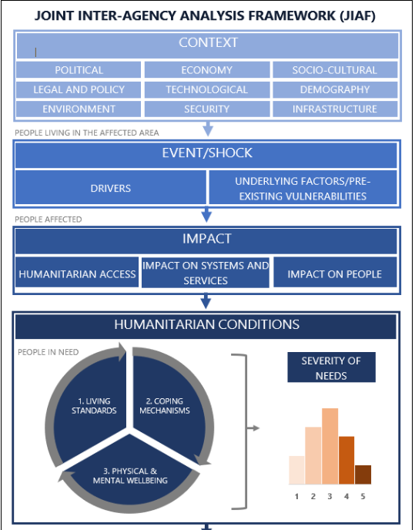
1) INTER-SECTORAL ANALYSIS
  Protection analysis fully integrated in context-shocks-impact analysis to identify affected areas and groups
  Protection indicators integrated in all HC pillars for intersectoral severity needs analysis and PIN calculations
  Simplified approach for aggregation: a single intersectoral PIN (not by sub-pillar)
  Specific considerations for data-limited scenarios (secondary data, proxy indicators)
  Integration of risk analysis (to be further developed in August)

Slide 31
1.1. Setting the scope of the analysis
Joint consolidation and analysis of context, shocks and impact information and indicators, with a strong focus on protection risks/ violations, as a main step in the JIAF aiming at establishing the scope of the analysis
Key outputs:
  Identification of priority affected geographic areas
  Identification of most affected / vulnerable population groups

Slide 32
Ukraine HNO 2020
Iraq HNO 2020

Slide 33
Why?
Ensure centrality of protection and cross-cutting issues informs the IS analysis
Sequential linkage between non-HC and HC Pillars
Provide the scope / baseline for severity analysis and PIN calculations (affected areas / affected groups)
Foster joint analysis / interpretation from the start of the process
Ensure analysis of humanitarian conditions / consequences is linked to key shocks / impacts
Baseline for building linkages with H-D Nexus analysis

Slide 34
How?
Step 1. Identify and consolidate available information and indicators.
Indicators for each specific context and aggregate or disaggregate them to the selected geographical unit of analysis.
  Context or environment in which humanitarian actors operate (policies and legal framework, security profile, socio-cultural and demographics characteristics, etc).
  Exposure of the population to different shocks and risks which define the humanitarian crisis in the given country (including conflict/violence and human rights violations, natural hazards, disease outbreaks, etc.)
  Impact of the crisis on affected population (including displacement / mobility), systems and services and humanitarian access.
  Key vulnerability characteristics (including based on age, gender and disability and other contextually relevant characteristics)

Slide 35
HOW
Step 2. Define context-based analysis of indicators.
With the support of the JIAF team and in country IMWG; Clusters and AoRs will decide on analysis of quantitative indicators thanks to their sectoral expertise.
  Binary
  Standards
  Ranks / ranges
  Thresholds

Slide 36
HOW
Step 3. Joint interpretation/analysis.
Plenary joint analysis sessions for analysis and interpretation for each of the geographical units of analysis.
Outcome of these sessions will be an Inter-sectoral consensus on the most affected geographical areas by the crisis.

Slide 37
HOW
Step 4. Identify and profile affected population groups.
Identification of the affected population groups in prioritized geographical areas, using estimates of the number of people affected as defined in the 2016 IASC Humanitarian profile Support Guidance.
  Affected group profiles
  Key vulnerable groups affected in a differentiated manner

Slide 38
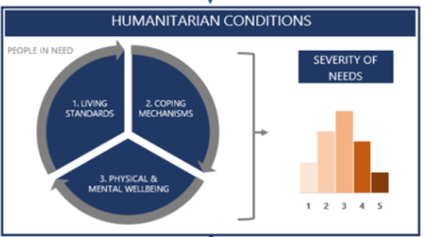
1.2. Severity analysis and PiN Calculations
  1 inter-sectoral PiN (no pin per pillar)
  Revised list of indicators and recommend thresholds
  Both HH and area-based considered equally
Current and forecasted priority needs/concerns (by relevant age, sex, gender disaggregations)

Slide 39
Focus also on narrative
  INTRODUCTION (CHAPEAU) TO HNO
  THREE PARTS: CONTEXT, SHOKCS, CRISIS IMPACT
  INTERSECTORAL PILLARS
    SEVERITY / PIN
    UNDERLYING FACTORS

Slide 40
2) SECTORAL ANALYSIS
  Take indicators as the ones identified for inter-sectoral analysis (Plus additional ones (e.g. if they were cut but important for your sectoral ranking)
    GPC & AORs will provide support to adapt thresholds as needed
  Joint severity analysis (overarching and specific) as in 2020 Guidance
    Jointly agree on overall protection severity score per area / group
  PiN calculations linked to severity scores and baseline figures of affected / vulnerable groups in prioritiy areas

Slide 41
Key recommendations
  Use variety of sources / Secondary data review
  Key focus on identifying priority areas and population groups
  Don’t get stuck in ‘mathematical’ PiN calculations - focus on quality narrative
  Highlight groups with specific needs, context-specific, priority areas

Slide 42
DISCUSSION
Questions on the process / approach changes?
Additional challenges / areas that need focus and guidance / support from global team?
Good practices / lessons learn to highlight?
Notes:
30 min

Slide 43
4. WRAP UP AND CLOSING REMAKRS

Slide 44
1) Greater focus on integrated protection analysis and enhanced response planning
- Focus on ensuring centrality of protection and inclusivity by ensuring that protection risks inform the overall collective analysis – not only through identified protection indicators, but also and most importantly through expert inputs in the collective analysis exercises and key common narrative sections (i.e. context, impact, consequences of the crisis)
- Integrated programming needs to spearhead our engagement with other sectors towards collective protection outcomes and contributing to the principles and objectives of the Centrality of Protection in humanitarian action
- Comprensive response planning (operational footprint)

Slide 45
2) We need to enhance and harmonized our results framework and response monitoring systems to demonstrate the quality and protection outcomes of field protection responses
- We will be working on guidance for harmonizing the formulation of results-based strategic objectives based on the affected population priorities, to inform multi-sectoral and sectoral planning
- As well as developing guidance to enhance targeting and estimation of financial requirements (costing) in a comprehensive manner
- Providing support to establish response monitoring systems that allow for better analysis of the evolving situation, measuring it against outcomes

Slide 46
3) Field Support: The global team of GPC and its AoR will work as one to guide / support you during 2021 HPC processes
- Dedicated team to provide remote support and as required field support as much as possible – more details to be provided soon
- Global advocacy support with OCHA, Global Clusters, Lead Agencies and Donors as needed

Slide 47
THANKS!

