Slide 1
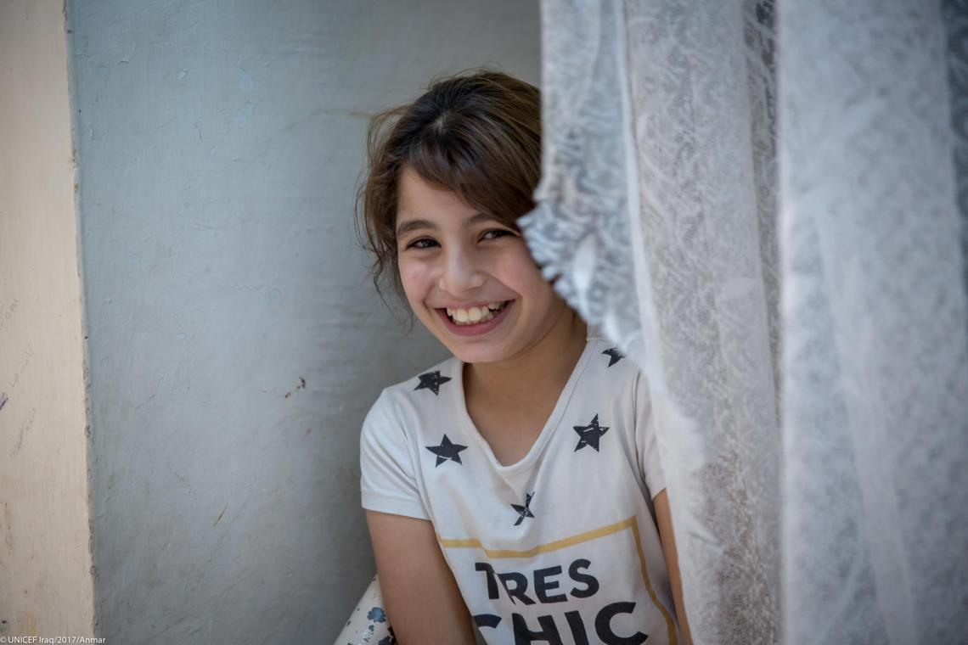
Welcome to the workshop on Violence Prevention!
By the Global Child Protection Area of Responsibility
in partnership with World Vision
Virtual training, 1. – 3.December 2021

Slide 2
Housekeeping Items
Please feel free to introduce your self in the chatbox
Please make sure your name is displaced
Turn off your microphone/ camera while you´re not speaking or presenting
Raise hands if you have any questions and/ or put your questions in the chat box at any time during the session
Engage in discussions/ activities to share your views and expierences
Materials will be shared after the workshop
The session will not get recorded

Slide 3
Objectives
Core Components and Outcomes of Parenting Programmes
How to deliver Parenting Programmes

Slide 4
A public health approach What distinguishes a public health approach?
Focus on prevention
By identifying risk factors and trying to generate programs that occur before harms occur, a public health approach helps us to rationalize resources and to avoid violence that should be avoided anyone
Focus on programs that are evidence-based, using rigorous methods
Programs may still require adaptation to local contexts, but experimental research designs have demonstrated that the core components of programs are effective in prevention and reducing violence against children
Use of a life-course analysis
Notes:
Recap from previous day

Slide 5
Prevention Pyramid of a Public Health Approach
Tertiary
Secondary
Primary
Tertiary prevention or response
Supports survivors and holds perpetrators to account
(and aims to prevent the reoccurence of violence)
Help is here
Secondary prevention or early interventions
Aims to `change the trajectory`for individuals at higher than average risk of perpetrating or experiencing violence
Get in early
Primary prevention
Whole of population initiatives that address the primary (´first or underlying) drivers of violence
Stop it before it starts
Notes:
Recap

Slide 6
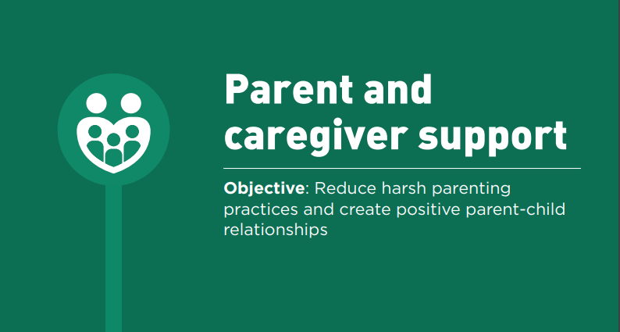

Slide 7
Let’s talk
Question:
Share a time that you remember either:
A strong feeling that you had with your parents as a child
A conflict that you had with your child as a parent
Notes:
7 minutes

Slide 8
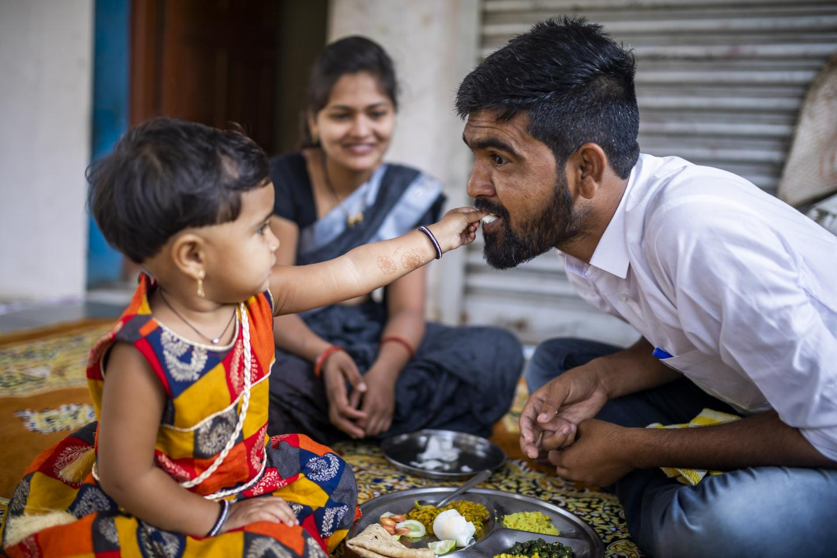
What do Parenting Programs do
Help parents learn skills that are useful to them in their culture
Understand that every child and relationship to parent is different – even in a group setting
Manage children´s behaviour and offer alternatives to harsh and physical punishment
Understand children´s development, set realistic expectations, improve parent-child communication
Build resilience by teaching caregivers and children emotional regulation, problem-solving, and social skills
Provide opportunities to practice skills: Active learning, discussions, coaching, modelling, lectures, and …
PRACTISING, PRACTISING, PRACTISING !!!

Slide 9
Which skills?
Positive parenting focuses on creating safe home environments and building a foundation of support and care for children through affection, quality time, praise, and healthy methods of dealing with difficult behaviour, such as positive discipline that teaches pro-social behaviour
Nurturing parenting involves helping children develop healthy social and emotional behaviours, teaching life skills, and promoting well-being through modeling healthy ways to solve problems and communicate feelings
Positive discipline
refers to praising, rewarding, supporting good behaviour, and non-violent responses to misbehaviour that take children’s cognitive and emotional stage into account, such as natural or logical consequences, time-out or taking breaks, and redirection.
Can you think of any examples?

Slide 10
Theory of Change
Common Components
Role-plays
Facilitator empathy
Modelling parenting
Participatory, non-didactic learning
Group discussions & problem solving
Supportive materials (e.g., audio-visual)
Peer support
Parenting Skills
Quality time together
Child-directed play
Socio-emotional regulation
Positive reinforcement
Giving instructions
Limit setting, rules, monitoring
Nonviolent discipline
Stress reduction
Parenting Outcomes
Reduced harsh parenting
Increased parental confidence
Increased positive parenting skills
Improved monitoring & supervision
Reduced support for corporal punishment
Adult Outcomes
Reduced mental health problems
Reduced intimate partner violence and coercion
Child Outcomes
Reduced child behavior problems
Improved socio-emotional regulation
Improved child development

Slide 11
Indicators
Non-violent discipline by caregivers, past month
Early childhood caregiver engagement and nurturing
Parent/ guardian understanding of adolescents´problems, past month
Parent/ guardian supervision of adolescents, past month

Slide 12
Notes:
Slide: Evidence from 77 Systematic Reviews
And we have really strong evidence on the effectiveness on parenting interventions from over 77 systematic reviews. And in low and middle income countries a group of researchers just receently identified over a 125 randomized control trials of parenting interventions demonstrating a robust level of effectiveness in high income countries and emerging economies. It was also looked at some meta-analysis how parenting programs can be transported across settings. They have found that they can be equally effective between looking at those who are originated in a country or that are transported form one setting to another as long as they are based on the core components.
It was also found that poor families, those who are most vulnerable, single-mother families, migrant and ethnic minorities are likely to benefit just as much as average families. And that parenting programs can be equally effective for those who are young or with older children. So it is not too late to intervene to support parents.
There are also really promising examples of how national governments and UN agencies, academics and civil society partners have worked together to have national approaches to parenting interventions (South Africa, Cambodia, Zambia…). In Thailand they are working with the ministry of public health, different kind of sector, but it points out how parenting support can be done as part of health promotion

Slide 13
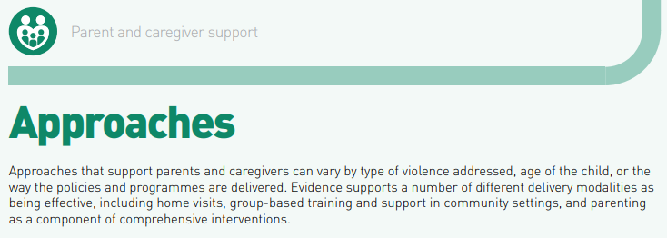

Slide 14
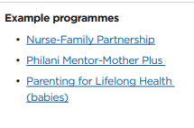
Approaches Home-Visiting Programmes
Populations/ settings
First time, low-income pregnant women and mothers of children up to age 3 years, of those identified as „at risk“ within a community or area
Cost: $$ - $$$
Potential outcomes
Reduced child abuse and neglect
Variety of ECD outcomes
Prevention of family separation

Slide 15
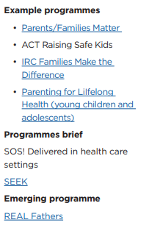
Approaches Parenting Groups in community settings
Populations/ settings
Parent and caregivers
Cost: $ - $$
Depends on duration of programme, number of home visits, and skill level of staff
Potential outcomes
Reduced physical punishment
Improved child behaviour
Improved parent-child relationship and communication

Slide 16
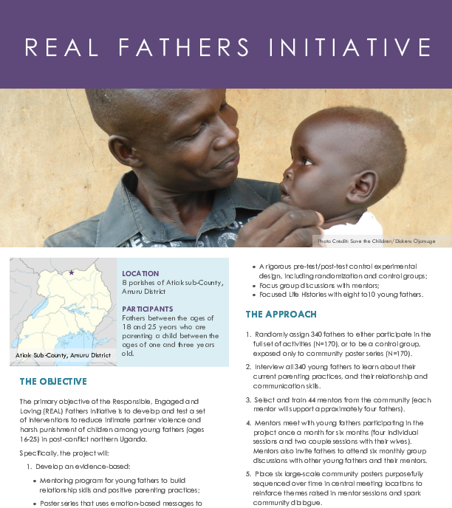

Slide 18
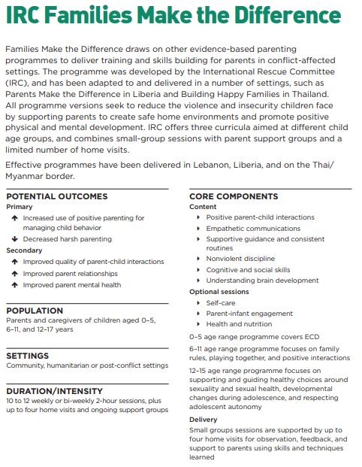
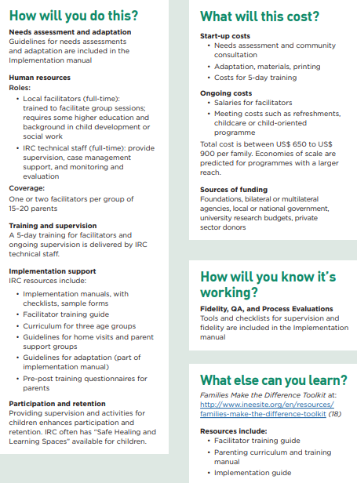
Notes:
Video start by 1:09:20 – 1:20:40 → ~11 minutes
Source: https://inee.org/resources/families-make-difference-toolkit

Slide 19
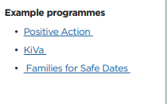
Approaches Comprehensive Programmes
Populations/ settings
All parents of children/ adolescents
Cost: $-$$$
Additive cost to other programmes
Potential outcomes
Reduced bullying or being bullied
Economically vulnerable families
Reduced IPV in victimization by intimate partners or peers
Improved parent-child communication

Slide 20
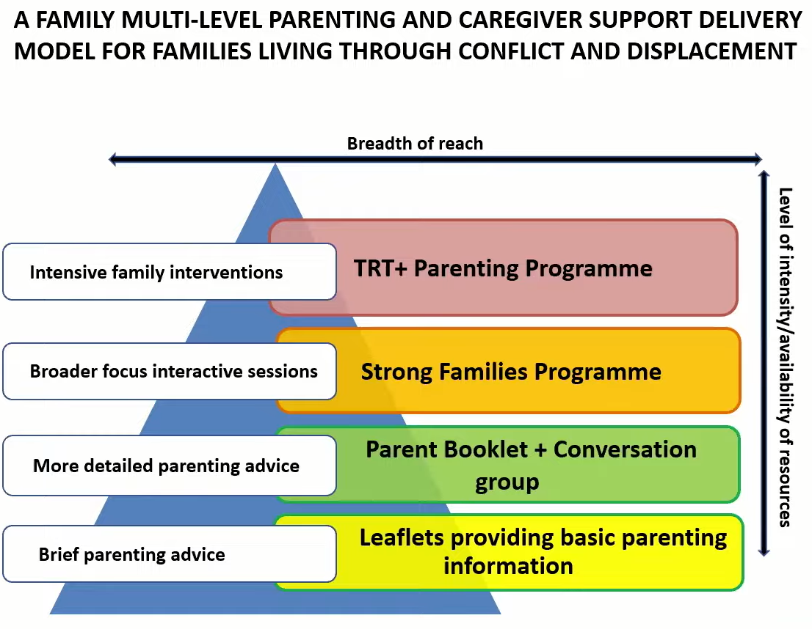
Approaches Comprehensive Programmes

Slide 21
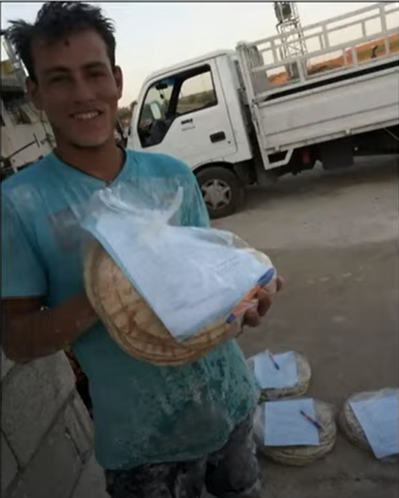

Slide 22
Approaches Comprehensive Programmes

Slide 23
BREAK
5 Minutes

Slide 24
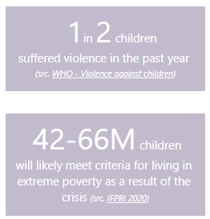
Children impacted and/ or risk due to Covid-19
Impacted by a pandemic increased fear and anxiety
Experienced loss of loved ones causes sadness and trauma
Harsh government restrictions to prevent the spread
Economic insecurity
…
→ Risks for child safety
Notes:
https://app.powerbi.com/view?r=eyJrIjoiNWY0Nzg2NWYtMWZhOC00YTFhLThkNTAtNGEwNDU4MzA4OTBlIiwidCI6Ijc3NDEwMTk1LTE0ZTEtNGZiOC05MDRiLWFiMTg5MjAyMzY2NyIsImMiOjh9
Report: Children: The Hidden Pandemic 2021

Slide 25
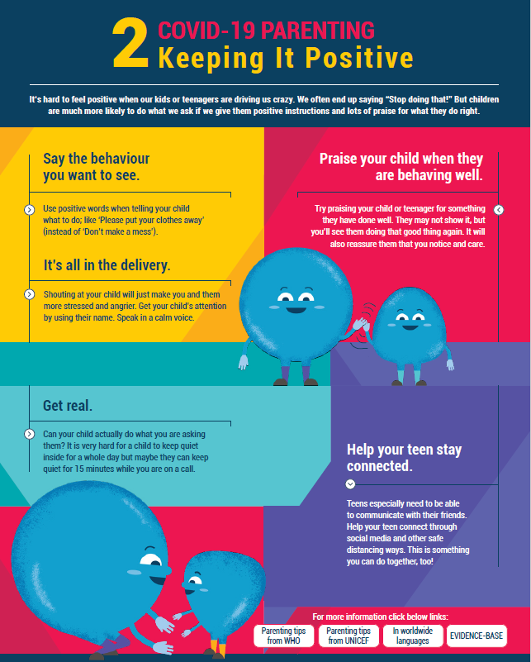
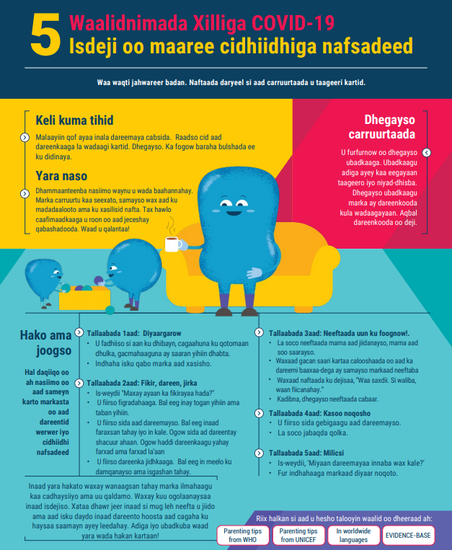
Parenting in times of Covid-19
Playful Parenting Emergency Response
One-on-one time
Keeping it positive
Structure up
Bad behaviour
Keep calm and manage stress
Talking about COVID-19
Protecting children online
Family budgeting in times of financial stress
Family harmony at home
Learning through play
When we get angry
Parenting in crowded homes and communities
Source: https://www.covid19parenting.com/#/home
Notes:
Derived from rigorously tested evidence-based programme
Content adapted to fit COVID-19 context
Developed as an inter-acengy effort. Developed with and reviewed by UNICEF, WHO, CD, USAID, and Global Partnership to End Violence
Simplified for transportability across cultures and contexts
Relevant for non-COVID-19 contexts
15 Parenting Tip Sheets
Tip Sheets got translated into over 100 languages
They are open source
Social Media, Radio, TV, YouTube, webinars
Every one of these topics can access you to a new leaflet. Additionally there is video materials that summarizes them and can easily disseminated via whatsapp, sms etc.

Slide 26
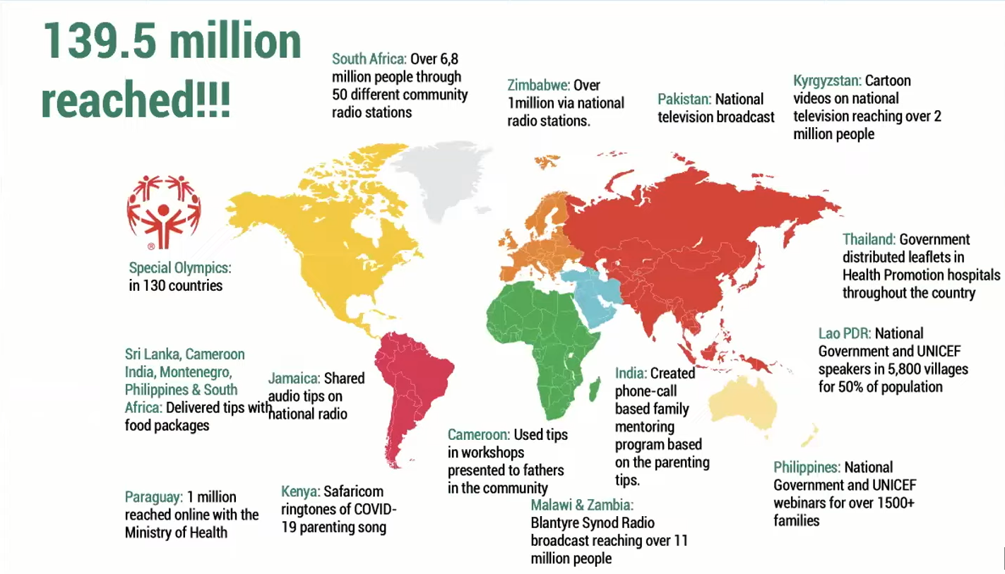
Source: https://www.covid19parenting.com/#/home

Slide 27
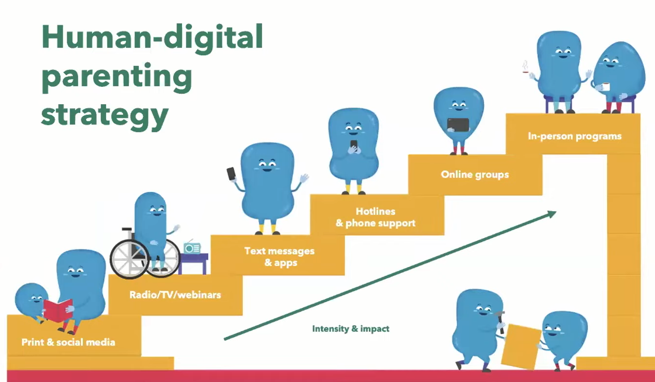
Source: https://www.covid19parenting.com/#/home

Slide 28
Your Approaches
How did you support parent and caregiver
in times of COVID-19?

Slide 29
Parenting in times of Covid-19
Source: https://youtu.be/nI8ADw6D2Ug
Notes:
Source: https://youtu.be/nI8ADw6D2Ug

Slide 30
Parenting in times of Covid-19
Science of Care
Affection
Family Activties
Play
Active Listening
Patience
Routine
Keeping Busy
Information
Praise
Physical activity
Source: LISTEN FIRST www.unodc.org/unodc/en/listen-first/parenting-resources.html
Notes:
https://www.unodc.org/unodc/en/listen-first/parenting-resources.html

Slide 31
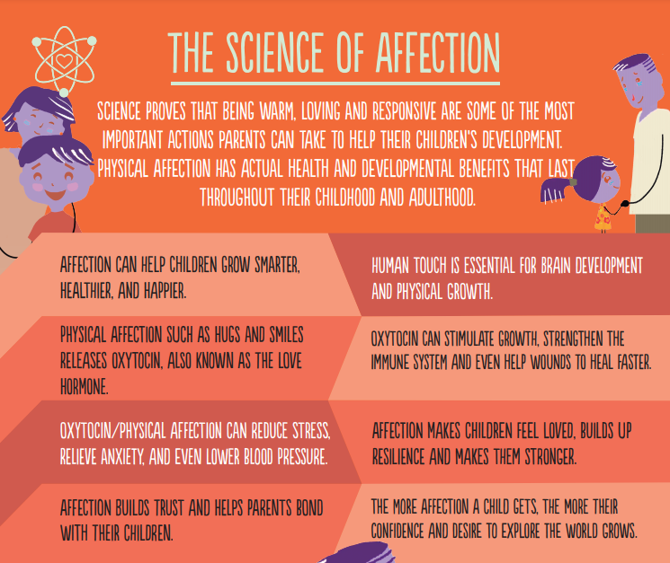
Parenting in times of Covid-19
Source: LISTEN FIRST www.unodc.org/unodc/en/listen-first/parenting-resources.html
Notes:
https://www.unodc.org/unodc/en/listen-first/parenting-resources.html

Slide 32
Parenting in times of Covid-19
Source: LISTEN FIRST www.unodc.org/unodc/en/listen-first/parenting-resources.html
Notes:
https://www.unodc.org/unodc/en/listen-first/parenting-resources.html

Slide 33
QUESTIONS
Notes:
https://www.menti.com/7fq3dch5t4

Slide 34
Exercise in Break-Out Rooms
What can be an adequate and possible approach to support parent and caregiver in your context?
Take a moment to reflect on your setting, your goals, what is already happening, and what you wish to change.
The purpose of this exercise is to help you focus on your priorities as you read more about the evidence-supported approaches and programmes:
What do you see as the main goal of parent and caregiver support? For example: To reduce home-based violence? To prevent family separation? To help children develop their full potential?
What outcomes are you most interested in affecting considering the risks and protective factors?
What are possible mechanisms for delivering parent and caregiver support, e.g. community or faith-based organizations, health systems or health care workers, social service system or social service workers, schools?
Based on your reflections above, what is your approach for strengthening the parent and caregiver in your setting?

Slide 35
How do you feel?
1
2
3
4
5
6

Slide 36
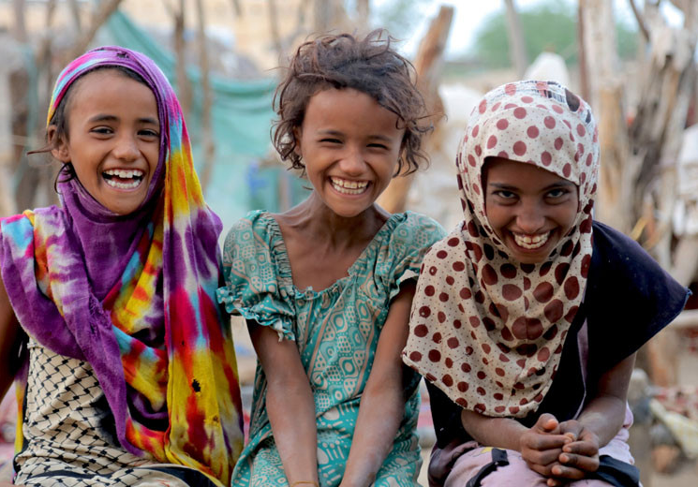
Thank you!
Next Session…
Session on Response and Support Services:
Friday, 3.12: 10am – 12pm

